Slide 1
Network Structure Inference: Methodology and Applications Committee: Prof. Tanya Berger-Wolf Prof. Lise Getoor Prof. Chris Kanich Prof. Elena Zheleva Prof. Brian Ziebart
Ivan Brugere
University of Illinois at Chicago
05/05/2020

Slide 2
Introduction
PhD, UIC, Computer Science 2020
Interdisciplinary ecology from population to ecosystem scales
Recent work in fairness: model fairness and allocation problems
Home communities: KDD, AAAI Social Impact
Focus on: Statistical methodology and interpretability
Hobbies: Music and (fixed-gear) cycling

Slide 3
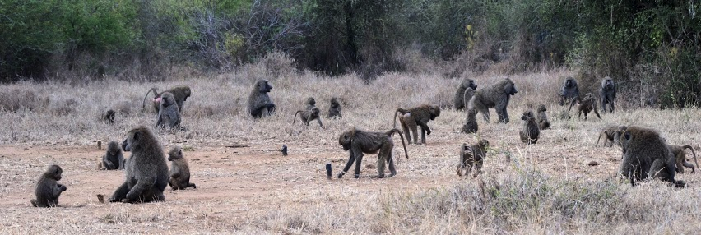
Motivation
Question: “Do social ties explain movement in baboons?”
Why?: Understand group decision-making and who is deciding
Data: GPS trajectory of individual baboons + individual attributes, inferred interactions.
Network definition: Many possible networks from (1) GPS, (2) age, (3) sex, (4) affiliates etc.
Utility: Network which is most predictive of movement
Impact: Hypothesis testing of different mechanisms of collective movement

Slide 4
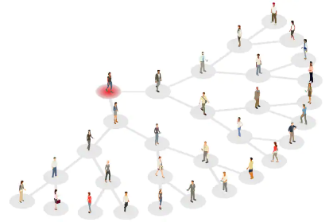
Motivation: Contact Tracing
Question: “What was the infection path of a virus spreading in a population by physical contact?”
Why?: Early alerting for infected individuals.
Data: Individual mobile phone locations
Noisy and complex: Closeness, time length, individual susceptibility, environment
Network definition:
e.g. CovidSafe (AU): “< 1.5 meters for more than 15 minutes”
Utility: Accurate transmission paths, coverage
Notes:
Challenges: Missing edges (e.g. no phone, no app), bias

Slide 5
Full details
I. Brugere, B. Gallagher, & T.Y. Berger-Wolf, (2018). Network Structure Inference, a Survey: Motivations, Methods, and Applications. ACM Computing Surveys (CSUR), 51(2), 24.
I. Brugere, B. Perozzi, P. Cui, W. Zhu, J. Pei, T.Y. Berger-Wolf, (2018) Modeling Data With Networks + Network Embedding: Problems, Methodologies and Frontiers. ACM SIGKDD 2018 Tutorials

Slide 6
Organization
Chapters 1-2: Network structure inference survey (ACM Computing Surveys). Application areas
Chapters 3: task-oriented network model selection, efficiency problem formulations
Chapter 4: Methodology for model selection (3-4 in submission: IEEE TKDE)
Chapter 5: Application study: baboon social network inference, interaction prediction (AAAI Workshop, Nature Scientific Reports)
Chapter 6: Privacy Shadow, measuring node predictability over time (in submission: KDD)

Slide 7
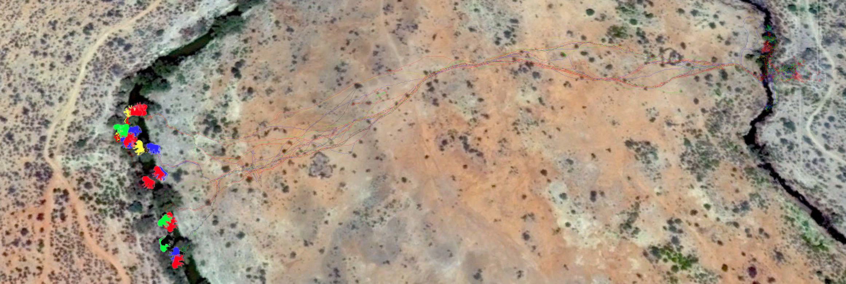
Predictive Evaluation: Inference
Infer and evaluate various network models, where neighbors predict an individual’s future location
Short-term Associations
Long-term Affiliations
Farine, D. R., Strandburg-Peshkin, A., Berger-Wolf, T., Ziebart, B., Brugere, I., Li, J., & Crofoot, M. C. (2016). Both nearest neighbours and long-term affiliates predict individual locations during collective movement in wild baboons. Nature Scientific Reports.
Notes:
MENTION: Our work: Nature Scientific Reports
Left (Association Network), Right (Affiliation Network)
Results:
Dunbar number: 4–6 individuals
Time scale: >10 minutes, affiliation networks better

Slide 8
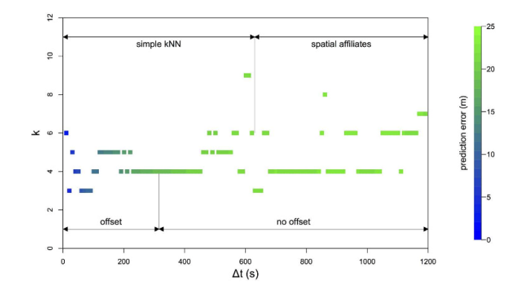
Selected networks and behavior
Selected networks give better understanding of troop behavior
Between 4-6 neighbors (of N=26)
Selected model changes to long-term affiliates (>10 minutes)

Slide 9
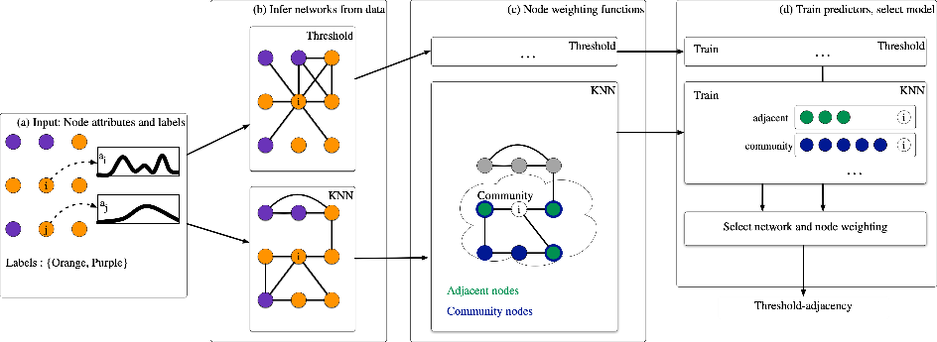
Task-focused Model Selection
Notes:
More details on workflow

Slide 10
Tasks and Datasets
Datasets:
Last.fm, music listen logs → tags
Movielens, movie ratings → tags
Beer advocate, beer ratings → beer types
Aminer, paper keywords → paper keywords
Tasks:
Label inference
Link prediction

Slide 11
Take-Away: Task-focused selection
Network model ranking is empirically consistent across different criteria.
Different networks perform better for different tasks.
Selecting on both tasks may yield a worse network for both.

Slide 12
Efficiency (Overview)
+

Slide 13
Efficiency (Overview)
Correct(
)
Bytes(
)

Slide 14
Take-away: Efficiency
Selecting on efficiency recovers the most accurate network, also simpler alternatives.
Model significance testing shows well-performing models are rare in the search space
Re-wiring demonstrates networks are more robust to noise than simpler models

Slide 15
Privacy Shadow
If we find a good network for behavior prediction, can it be used to violate user privacy over time?
Idea: Measure how long a node’s prior network can be used to re-infer the node’s current individual behavior (attributes)
Evaluates the network as a model of node behavior over time, in absence of user data.

Slide 16
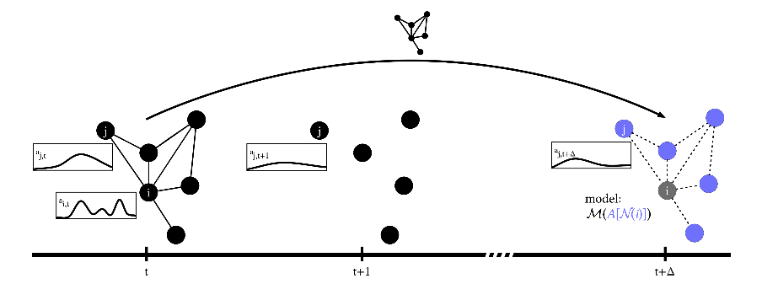
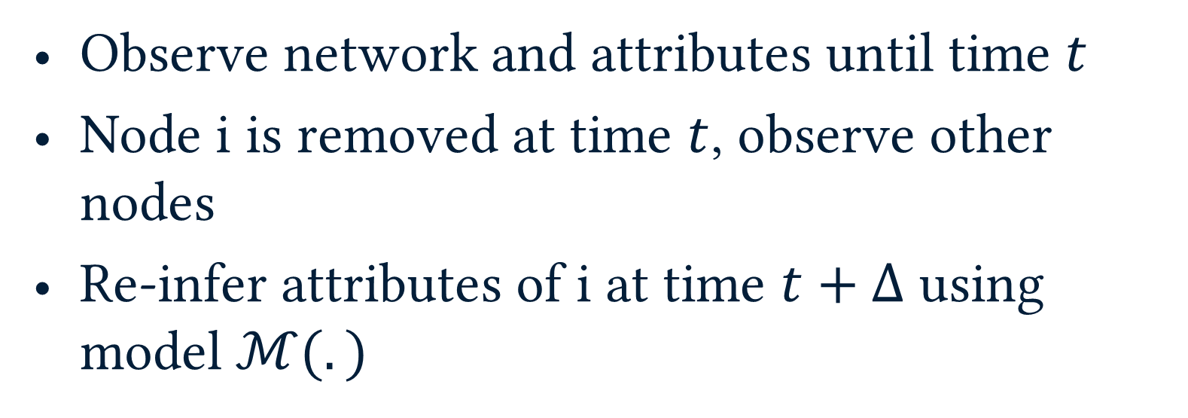
Privacy Shadow
Observe network and attributes until time $t$
Node i is removed at time $t$, observe other nodes
Re-infer attributes of i at time $t+Δ$ using model $ℳ(.)$

Slide 17
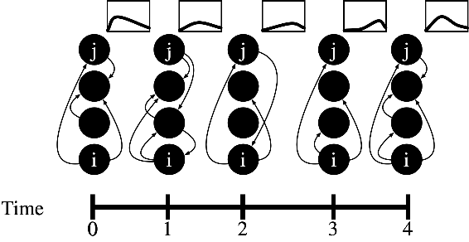
Privacy Shadow

Slide 18
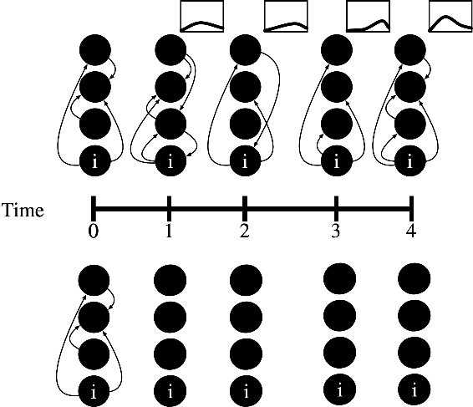
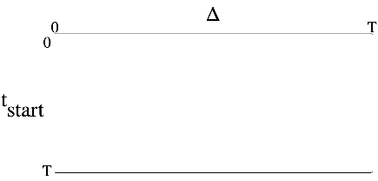
Privacy Shadow

Slide 19
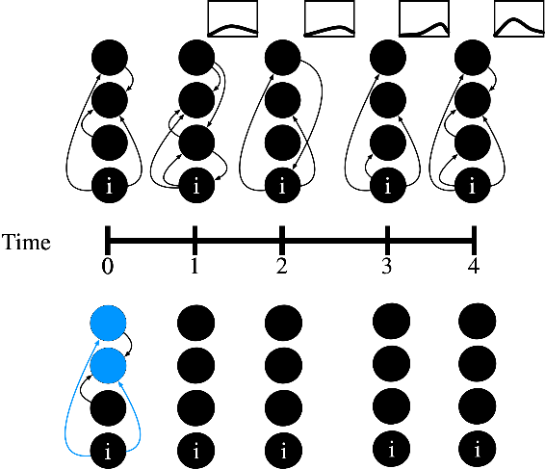
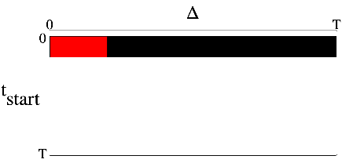
Privacy Shadow
Δ=0

Slide 20
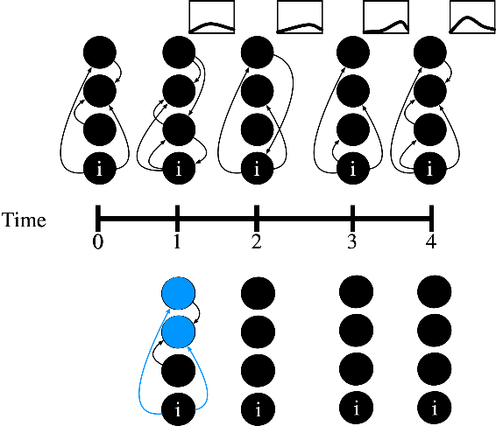
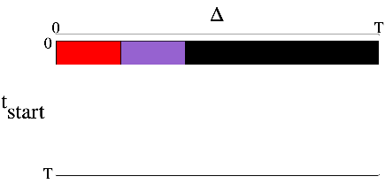
Privacy Shadow
Δ=1

Slide 21
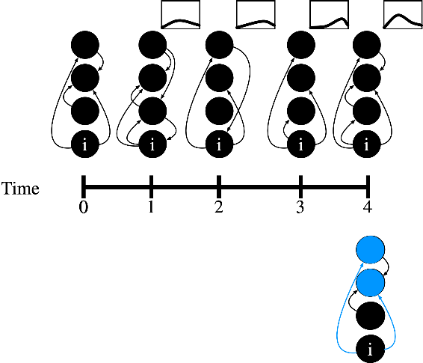
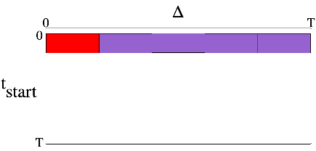
Privacy Shadow
Δ=4

Slide 22
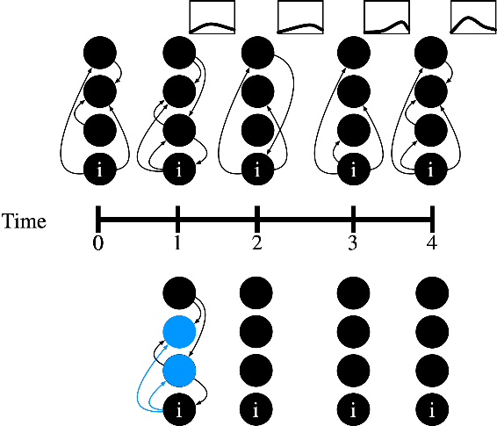
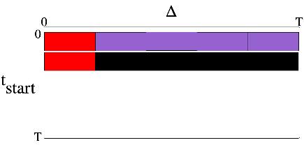
Privacy Shadow
Δ=0

Slide 23
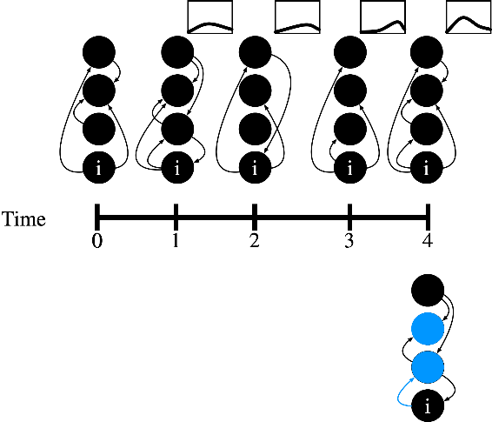
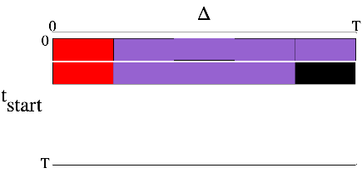
Privacy Shadow
Δ=3

Slide 24
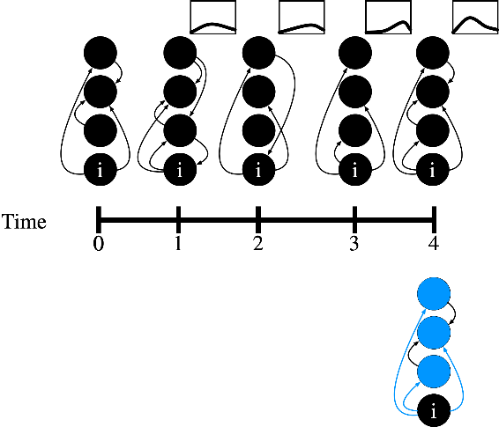
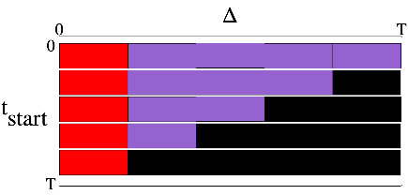
Privacy Shadow
Δ=0

Slide 25
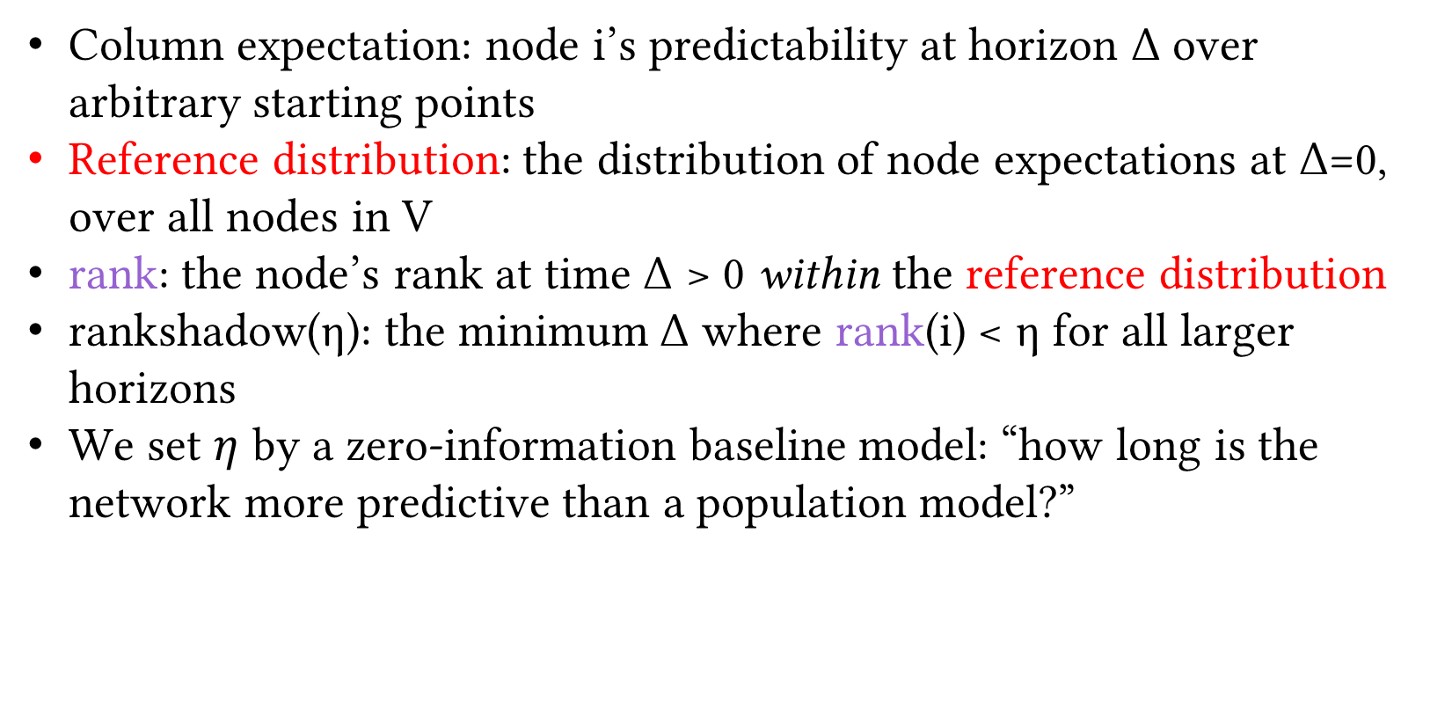
Privacy Shadow
Column expectation: node i’s predictability at horizon Δ over arbitrary starting points
Reference distribution: the distribution of node expectations at Δ=0, over all nodes in V
rank: the node’s rank at time Δ > 0 within the reference distribution
rankshadow(η): the minimum Δ where rank(i) < η for all larger horizons
We set $η$ by a zero-information baseline model: “how long is the network more predictive than a population model?”

Slide 26
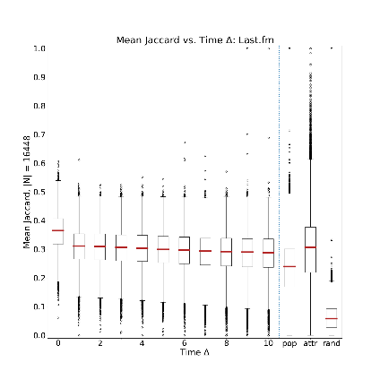
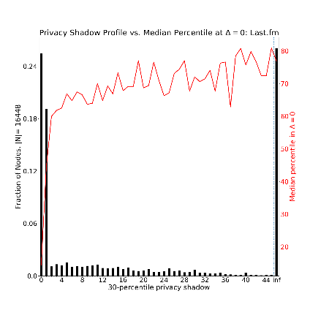
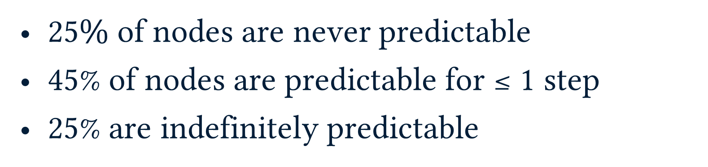
Results: Lastfm
$25\%$ of nodes are never predictable
45% of nodes are predictable for ≤ 1 step
25% are indefinitely predictable

Slide 27
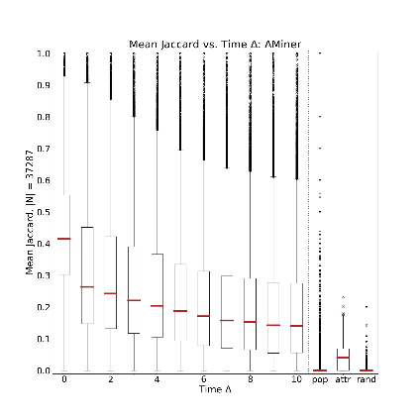
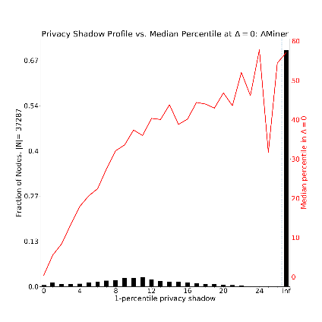
Results: Aminer
75% of nodes are indefinitely predictable
Strong network effect: attributes are very high-dimensional: 634K vs. >1K

Slide 28
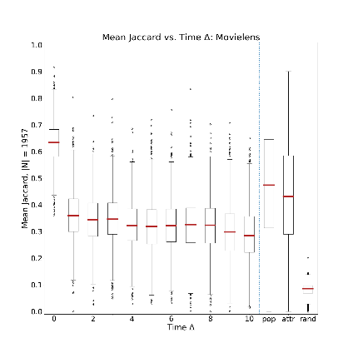
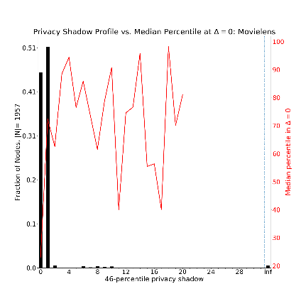
Results: Movielens
96% of nodes are predictable for ≤ 1 step
Not a (dynamic) network: neighbors aren’t predictive of future behavior

Slide 29
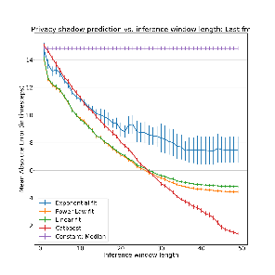
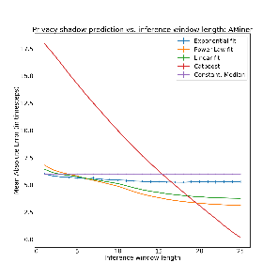
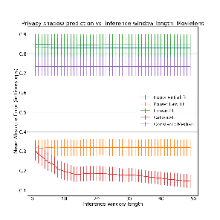
Results: Predicting Privacy Shadow
Given a training set of performance trajectory and privacy shadow lengths, predict privacy shadow.
Using extrapolation from fit, and gradient boosting

Slide 30
Conclusions and Future Work
Networks are routinely inferred and published with little consideration of sensitivity to tasks, time, etc.
We should not think of “the” abstract (Enron, Karate Club etc.) network without a question
Which results may have changed under different network definitions?

Slide 31
Future Work
Better models: my focus is on methodology. when are GNNs sensitive to network definition? (GNNs have high variance on a fixed network)
Multi-scale/efficient representation learning
Refining representations of greater cost (e.g. cluster-> network)
Equitable models: hard nodes yield trivial sparse predictors. Can we allocate model resources more fairly?
Improving Privacy Shadow:
Better length prediction: probably representation learning
Competitive zero-information baselines improve estimation

Slide 32
Thank You, Questions?

Slide 33
Questions as Graph Problems
Activity, location, gender, protein function, prediction/inference,
Friendship recommendation, product recommendation
Entity role/function comparison
Complex data emergent property classification/comparison
Label prediction/inference
Link prediction
Node embedding
Whole network embedding

Slide 34
“Why?” : Problem Scope
Thresholding, rule-based
“An edge exists if more than…”
Temporal data
Sampling rate and historical window
Multi-relational, multi-modal data
User-product purchases/product co-view graphs
User message-graph/user friendship graph
Missing Nodes or Interactions:
Network completion problems
Appropriate ML on our graph
Is our ML robust to graph samples/all the above
Aim: end-to-end learning from underlying data

Slide 35
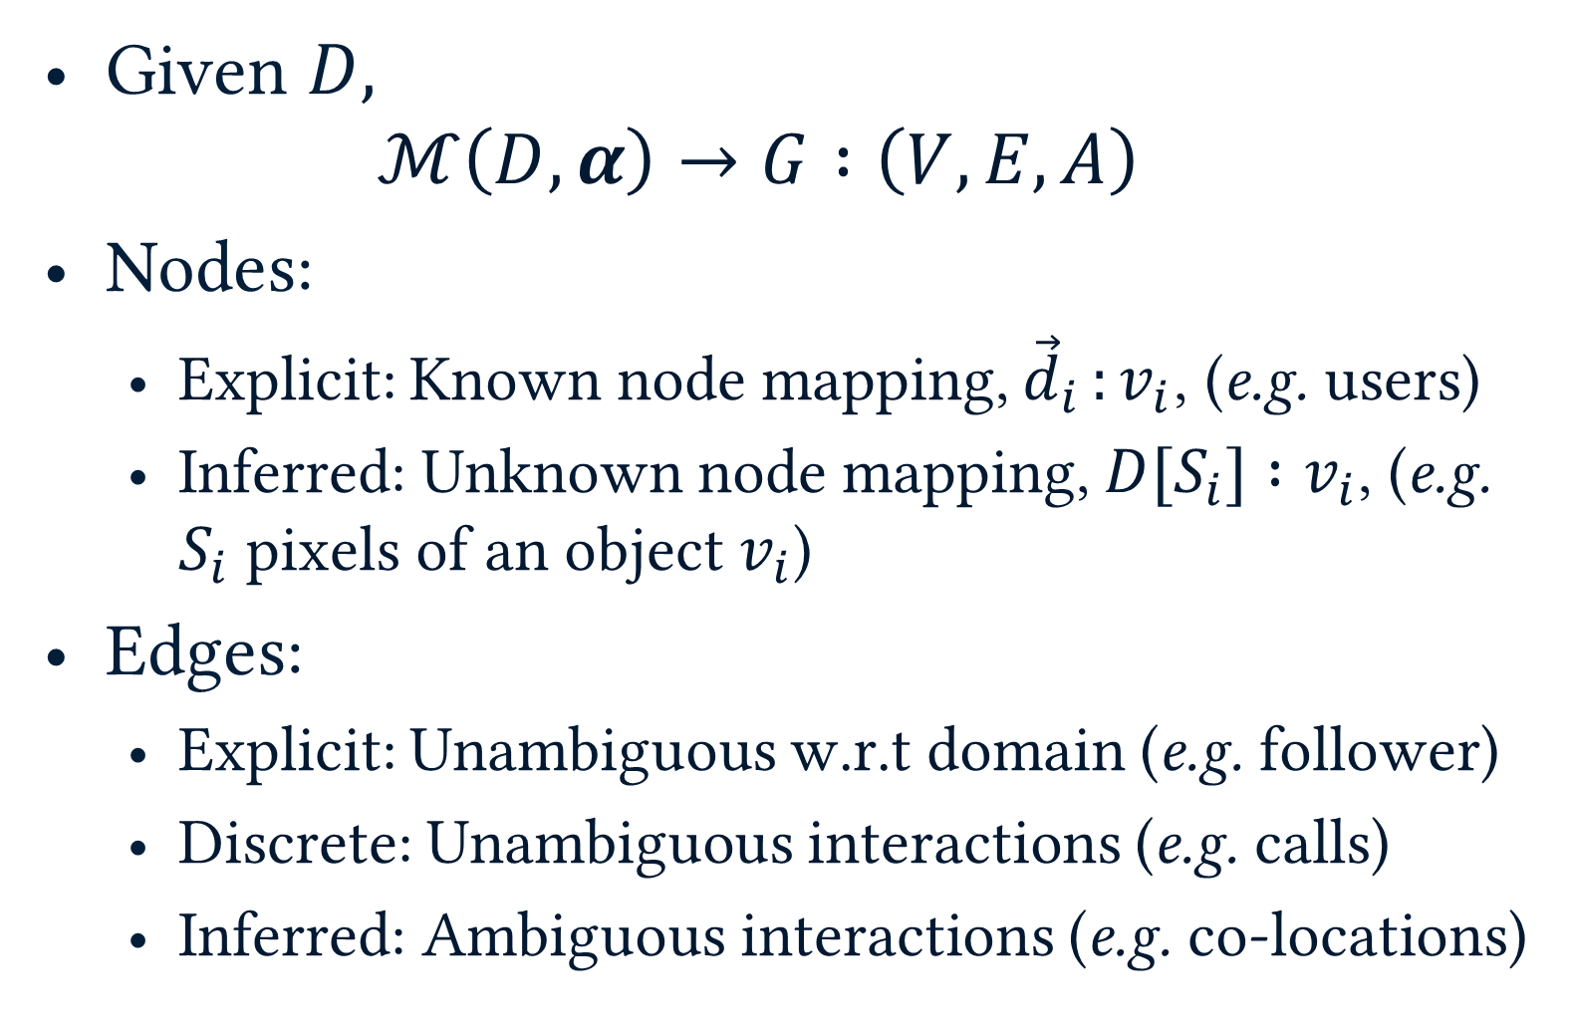
Network definition
Given $D,$
$$ℳ\left(D, α\right)→G :\left(V, E, A\right)$$
Nodes:
Explicit: Known node mapping, ${\vec{d}}_{i }:v_{i}$, (e.g. users)
Inferred: Unknown node mapping, $D[S_{i}] :v_{i}$, (e.g. $S_{i}$ pixels of an object $v_{i}$)
Edges:
Explicit: Unambiguous w.r.t domain (e.g. follower)
Discrete: Unambiguous interactions (e.g. calls)
Inferred: Ambiguous interactions (e.g. co-locations)

Slide 36
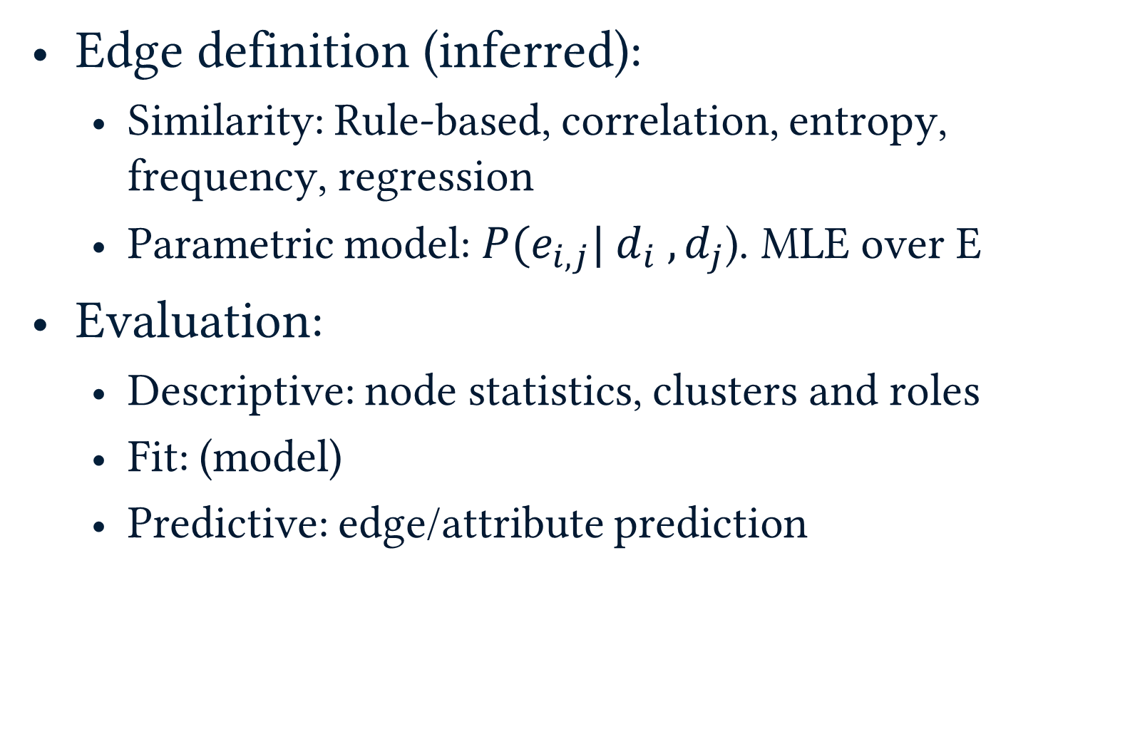
Network definition
Edge definition (inferred):
Similarity: Rule-based, correlation, entropy, frequency, regression
Parametric model: $P(e_{i,j}| d_{i} ,d_{j}$). MLE over E
Evaluation:
Descriptive: node statistics, clusters and roles
Fit: (model)
Predictive: edge/attribute prediction

Slide 37
Similarity Graph Models
k-nearest neighbor (KNN)
Threshold (TH)
Similarity graph
k=1

Slide 38
Datasets
Notes:
Table should be focus
Generate networks of varying density over models
Network model selection over many label-sets
Last.fm also has a user-defined social network

Slide 39
Precision and Rank Consistency
selected model consistent in each dataset
Worse than random:
Sparse ratings, coarse labels
Mean precision top-10 models
Precision Selected model
Consistent models
(Bold)
Consistent ranking
(Bold)
Notes:
1. Networks can do worse than random
2. want: consistency *and* good performance
Different localities selected per dataset/task
Localities > Model for selection
Bold: models in top-10%. (N > 100)

Slide 40
Cross-Task Model Selection
Same task: high stability
Different task: low stability
Average task: low stability
The best network depends on the task
There is no single graph for all tasks
Notes:
Better task models don’t matter if we’re using the wrong network.
Cant have general purpose networks

Slide 41
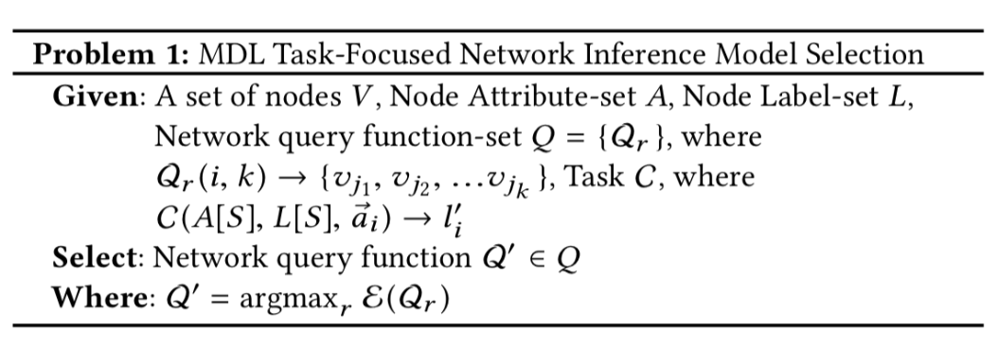
Efficiency-based Model Selection
Maximum efficiency model

Slide 42
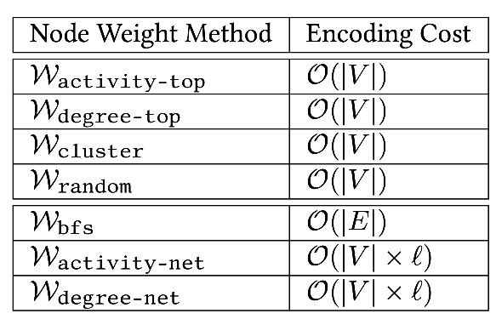
Node weighting Functions
Input: node i, size k, …
Output: k-length list of nodes
Notes:
Use: Kernels

Slide 43
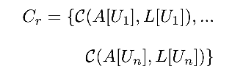
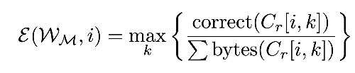
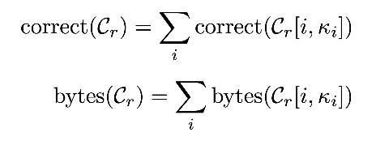
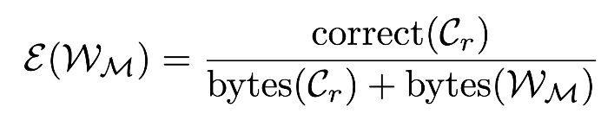
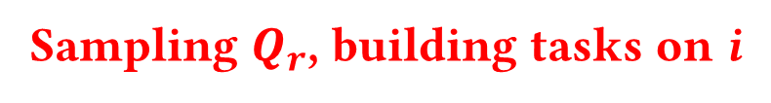
Efficiency: Node Tasks
Sampling $Q_{r}$, building tasks on i
Efficiency on v_{i}
Aggregation over nodes
Task encoding cost
Network encoding cost

Slide 44
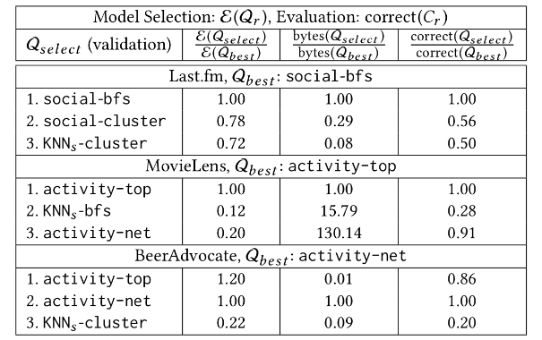
Model Selection Results
Selects the best model (w.r.t. correct)
Finds inexpensive alternative models
Top-ranked model is not a graph
Notes:
MovieLens and BeerAdvocate don’t actually have networks. They have authorities

Slide 45
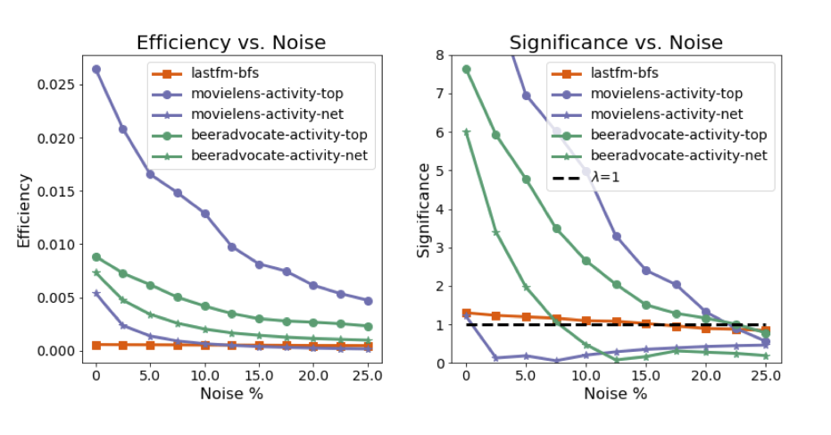
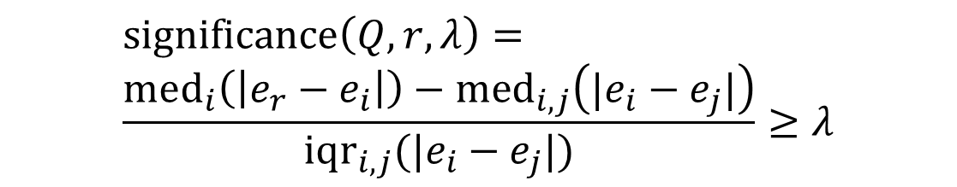
Model Significance
$$\text{significance}\left(Q,r,λ\right)= \\ \frac{\text{me}{\text{d}}_{i}\left(\left|e_{r}−e_{i}\right|\right)−\text{me}{\text{d}}_{i,j}\left(|e_{i}−e_{j}|\right)}{\text{iq}{\text{r}}_{i,j}(|e_{i}−e_{j}|)}≥λ$$
Median Δefficiency of Q_{r} vs. all
Median pairwise Δefficiency
Inter-quartile range, pairwise Δefficiency
Significance factor (similar to z-score)
Notes:
TEST Significance over a collection of networks
– If any model performs well, do we have a network?
40 bytes/correct, movielens activity-top
400 bytes/correct lastfm
Actual network much more robust to noise

Slide 46
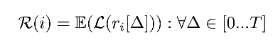
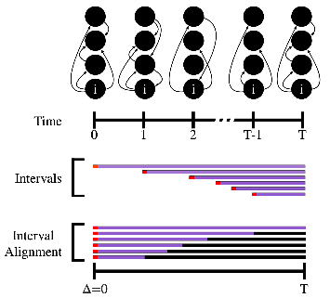
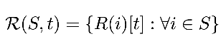
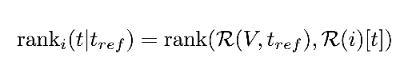
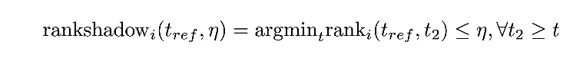
Privacy Shadow
Vector of expectations of node i performance
(e.g. expectation over alignment column)
Distribution of expected performance of S nodes at time t
Rank of node i at time t within the reference distribution at time t_{ref}
The minimum time index t where node i is never better than $η$ in the reference distribution
Set $η$ by a zero-information baseline model: “how long is the network more predictive than a population model?”

Slide 47
Hard Break
Current work

Slide 48


Graph convolutional networks
G = (V, E, A)
A input attributes
h_{i}^{l} node representations
Similarly edge reps.
$M=(W_{1}, …W_{L})$
$h_{i}^{l+1}=σ{\left(W^{l}f\left(h_{j}^{l}\right)\right)}_{j∈N(i)}$
See: tkipf.github.io/misc/SlidesCambridge.pdf

Slide 49




Graph convolutional networks
$$h_{i}^{l+1}=σ{\left(f\left(h_{j}^{l}W^{l}\right)\right)}_{j∈N(i)}$$
$$h_{i}^{1}$$

Slide 50


Graph attention networks
$$h_{i}^{l+1}=σ{\left(α_{ji}f\left(h_{j}^{l}W^{l}\right)\right)}_{j∈N(i)}$$
Where for attention function a():
$$α_{ij}=a(W^{l}h_{i}, W^{l}h_{j})$$

Slide 51

Full batch training
M = (W₁, W₂…W_{L}), H₀ = A
For l in 1…L
For i in V
$h_{i}^{l+1}={reduce}_{M}\left(pull\left(G, i\right)\right)$
backpropagation(M)
How to scale? We can sample $S⊂V$, but:
Need: robust gradient
Need: connectivity
otherwise we don’t learn w.r.t graph structure
Motivates: graph traversal methods

Slide 52
Open questions: end-to-end learning
“One of the hallmarks of deep learning has been its ability to perform complex computations over raw sensory data, such as images and text, yet it is unclear the best ways to convert sensory data into more structured representations like graphs”*
Graph convolution networks (typically on given graphs)
Recent work on learned graph structure:
Yang, Z., et al. (2018). GLoMo: Unsupervisedly Learned Relational Graphs as Transferable Representations. arXiv preprint arXiv:1806.05662.
Battaglia, P. W. et al. (2018). Relational inductive biases, deep learning, and graph networks. arXiv preprint arXiv:1806.01261.

Slide 53
“Structure is Everywhere”
Graphs are a convenient representation
So we tend to see graphs everywhere
But which problems are more natural with different representations?
Groups*, Streams**, Sets
*Tantipathananandh, C., Berger-Wolf, T., & Kempe, D. (2007). A framework for community identification in dynamic social networks. In Proceedings of the 13th ACM SIGKDD international conference on Knowledge discovery and data mining (pp. 717-726). ACM.
**Wu, C. Y., Ahmed, A., Beutel, A., Smola, A. J., & Jing, H. Recurrent recommender networks. In Proceedings of the tenth ACM international conference on web search and data mining (pp. 495-503). ACM.
**Koutra, D., Shah, N., Vogelstein, J. T., Gallagher, B., & Faloutsos, C. (2016). Delta C on: principled massive-graph similarity function with attribution. ACM Transactions on Knowledge Discovery from Data (TKDD), 10(3), 28.

Slide 54
Future Work
DSSG-programs: high impact, simple models
Capacity-building in non-profits (*solved*)
Fundamental challenges:
Scaling Domains:
Many domains are hand-written, hand-collected
e.g. No scalable UIDs in population biology
Build consistent representations over diverse inputs
Human-in-the-loop (e.g. active learning) in graphs
Graphs encode local bias (e.g. link prediction, political affiliation):
Local model sampling in equitable (e.g. unbiased control) representation learning

Slide 55


Motivation
(Traditional) Observational Science
Data Science
Answer questions on data, using a network representation
How do we define or infer the network?
How do we evaluate the utility of this choice?
Many choices for translating data to a network to answer questions
My thesis: these choices matter

